Slide 1
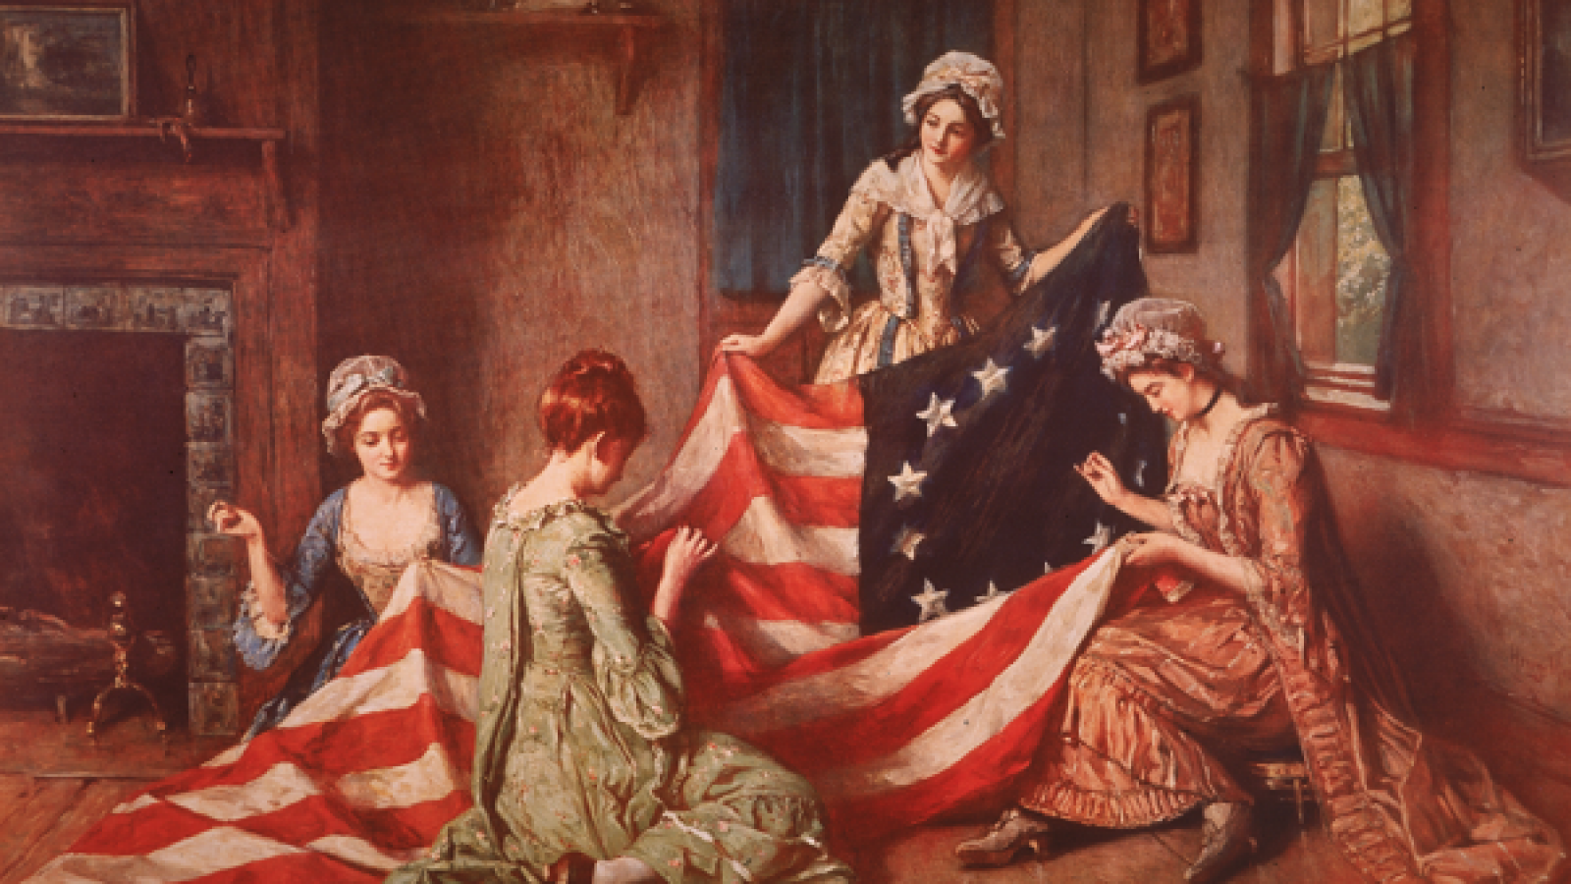
Impact of the Revolution
Lecture 14

Slide 2
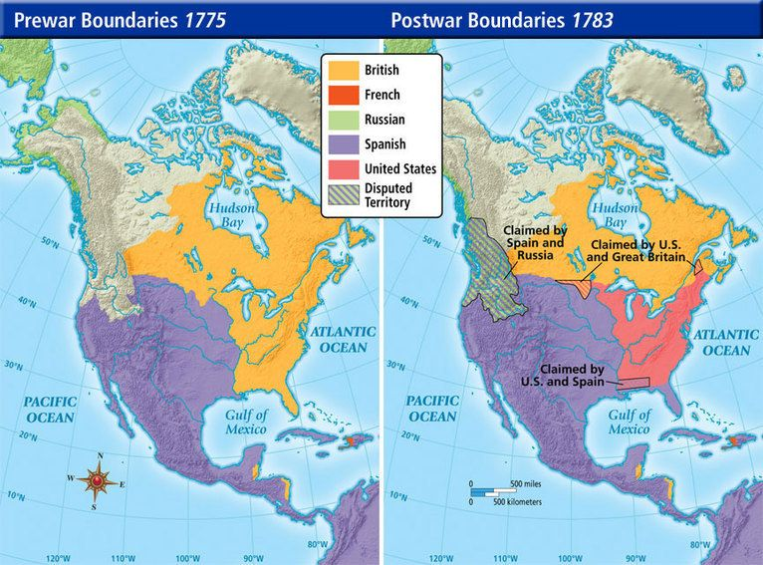
Treaty of Paris
1783: War officially ended with Treaty of Paris
English gave Americans all land east of Mississippi

Slide 3
Political
Created new nation made of 13 colonies called the United States of America
First successful revolt of a colony against an imperial power
Established the largest republic in world history
Republic: Government based on representative rule, not a monarchy

Slide 4
Political
Shift from "subject" to "citizen"
Subject: One who is subject to the laws of the king
Citizen: One who participates in the politics of a nation

Slide 5
Social
Many institutions remained the same with different leaders
Rich White men remained the heads of society
Social distinctions based on ability (wealth), not birth

Slide 6
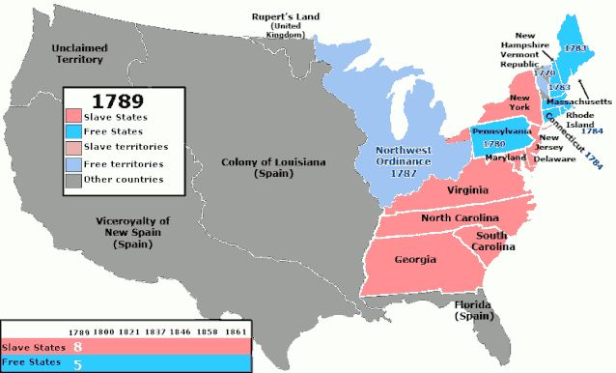
Racial
Many Revolutionary leaders were slaveowners
British pointed out hypocrisy of slaveowners complaining about "tyranny"
Revolutionary rhetoric softened racial views
Many southerners released their slaves; free black population went from 1% to 8% in VA
Northern states moved to abolish slavery, starting with Pennsylvania

Slide 7
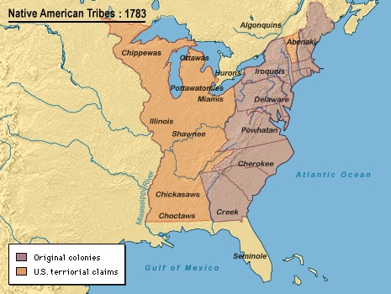
Native Americans
Had no representative at peace conference
British completely abandoned them, land given to USA
US began policy of excluding Indians from their land and politics

Slide 8
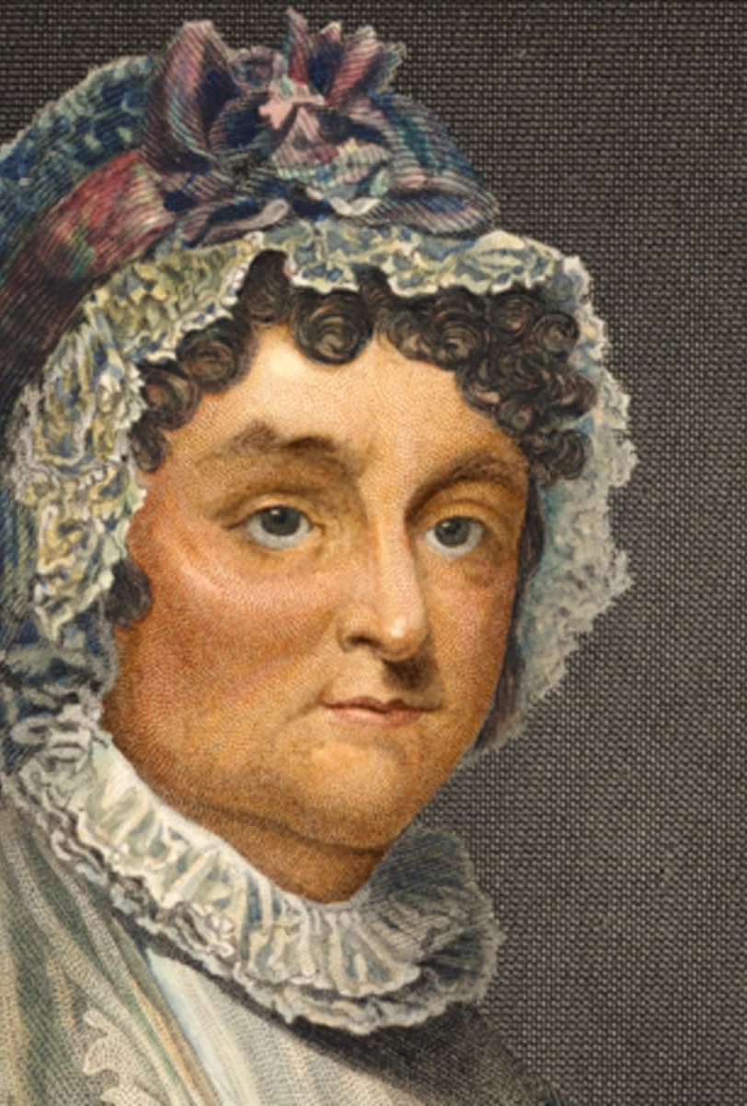
Gender
Women participated in protests
Supported Revolution in various ways; some even fought
Abigail Adams asked husband to "remember the ladies" at Congress; he laughed her off

Slide 9
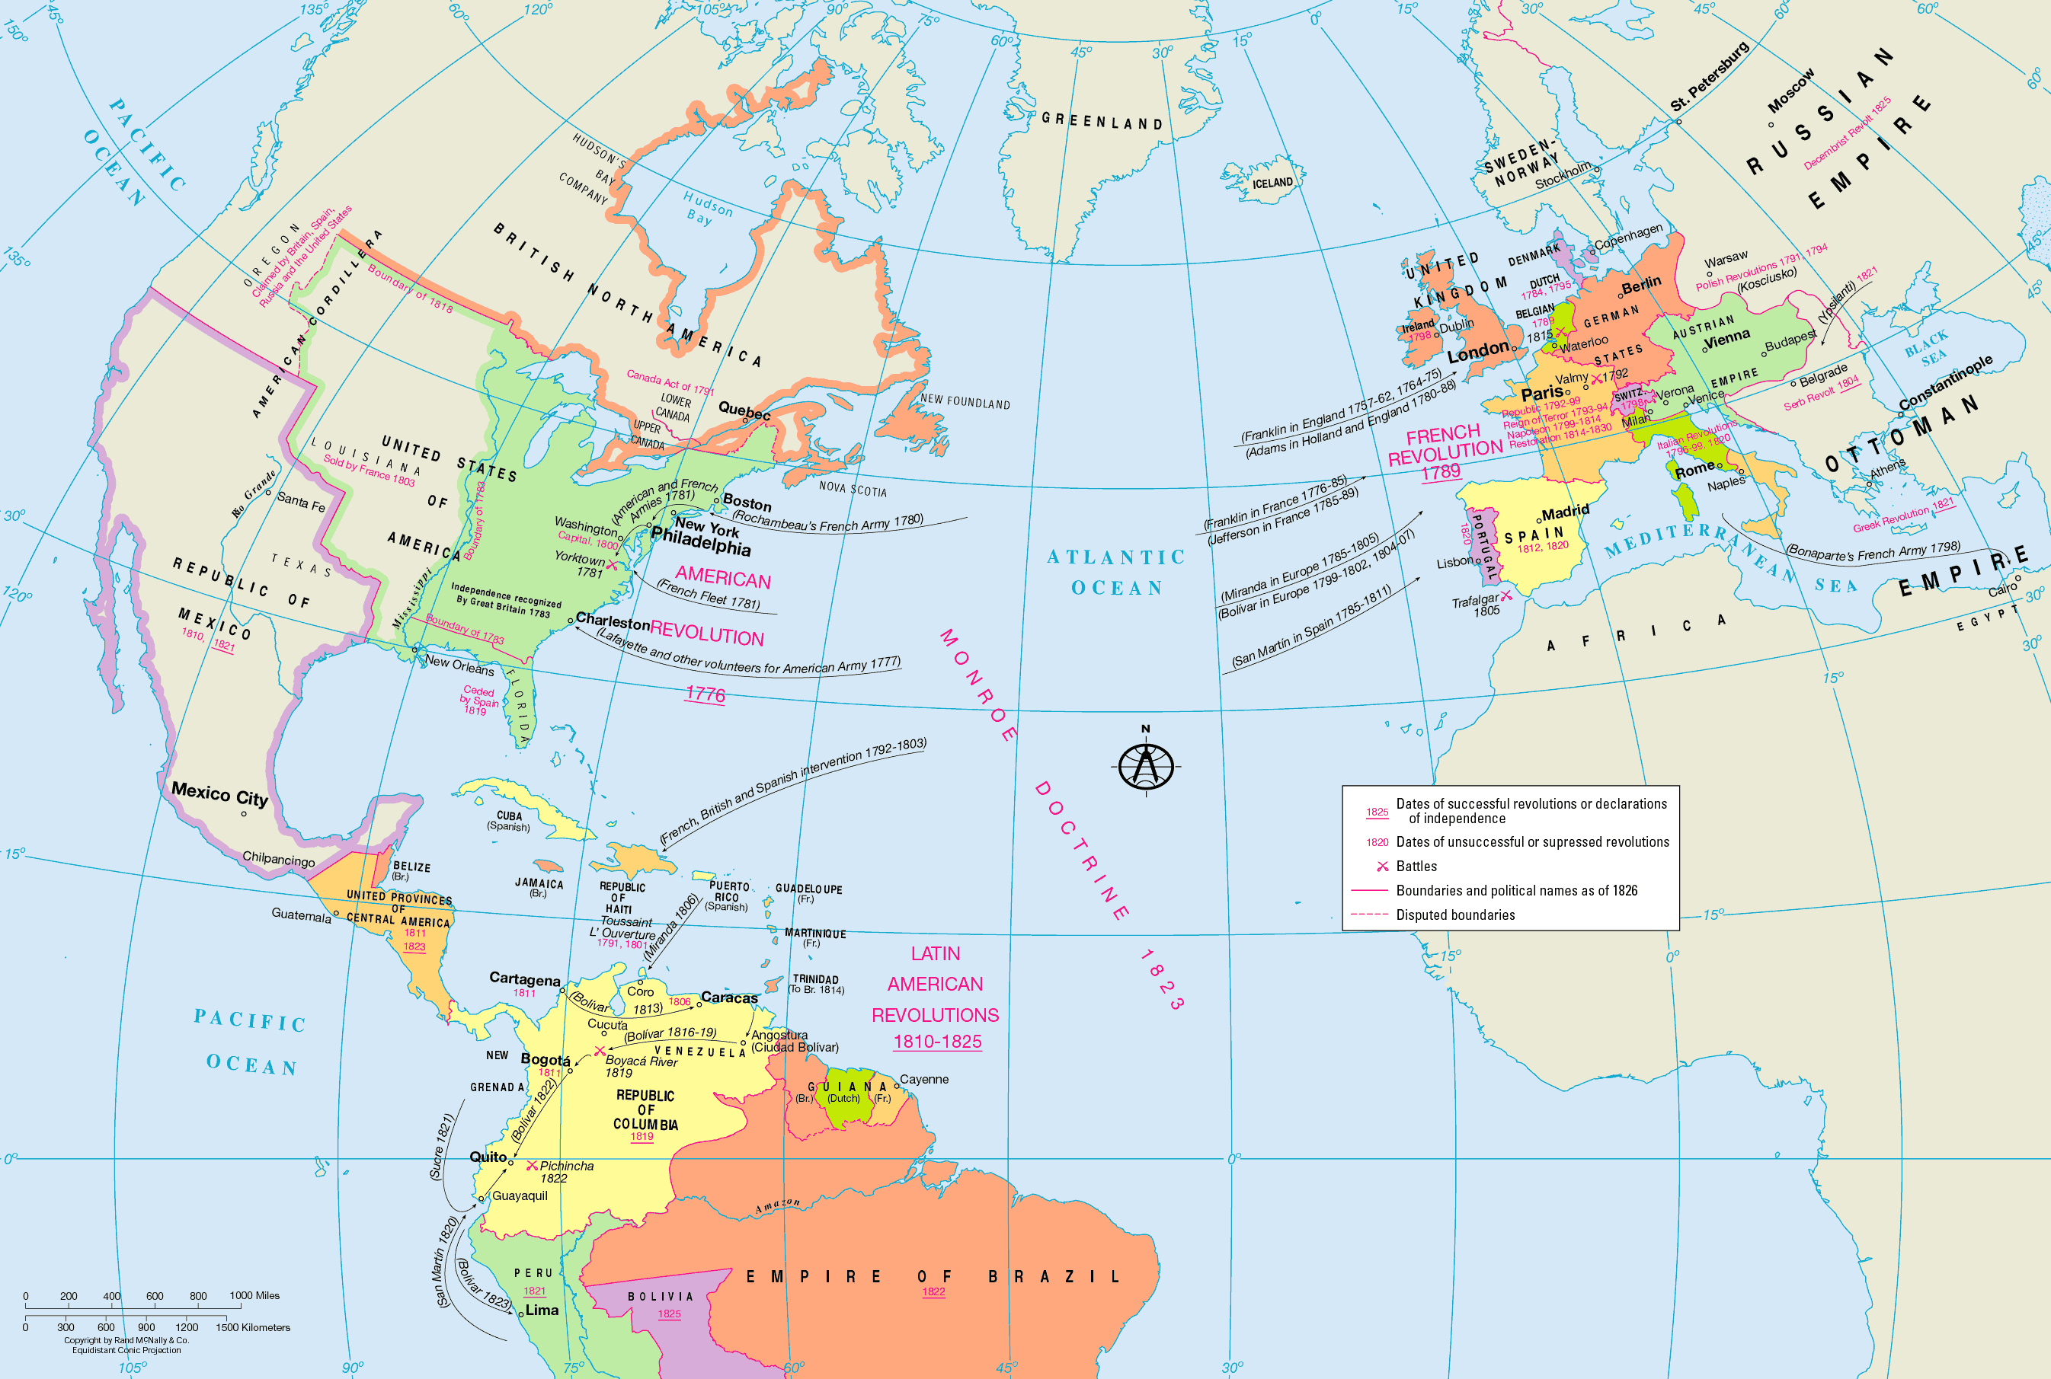
Global
"Atlantic Revolutions": Series of revolutions, starting in America, against colonial empires, kings and traditional politics
Includes:
French Revolution (1789-1815)
Haitian Revolution (1791-1804)
Latin American Revolutions (1808-1833)
Irish Rebellion (1798)

Slide 10
Global
Revolutionary ideals of freedom and equality became driving factor for global politics
Achieved Enlightenment's goal of self-rule

Slide 11
Religious
Challenged idea that monarchy was established by God
Led to greater freedom of religion

Slide 12
Loyalists
Loyalist: Those who retained loyalty to the British
Many had homes/land stolen
80,000 left for England
Some murdered by Patriots

Slide 13
Monarchy?
George Washington resigned as general
Example helped quell unrest among soldiers
Set precedent that American leaders would not have power forever

Slide 14
The American Revolution in Summary
Did not achieve immediate equality for all people; intentionally left out many groups
Established a philosophy and vocabulary for rights-based movements going forward

