Slide 1
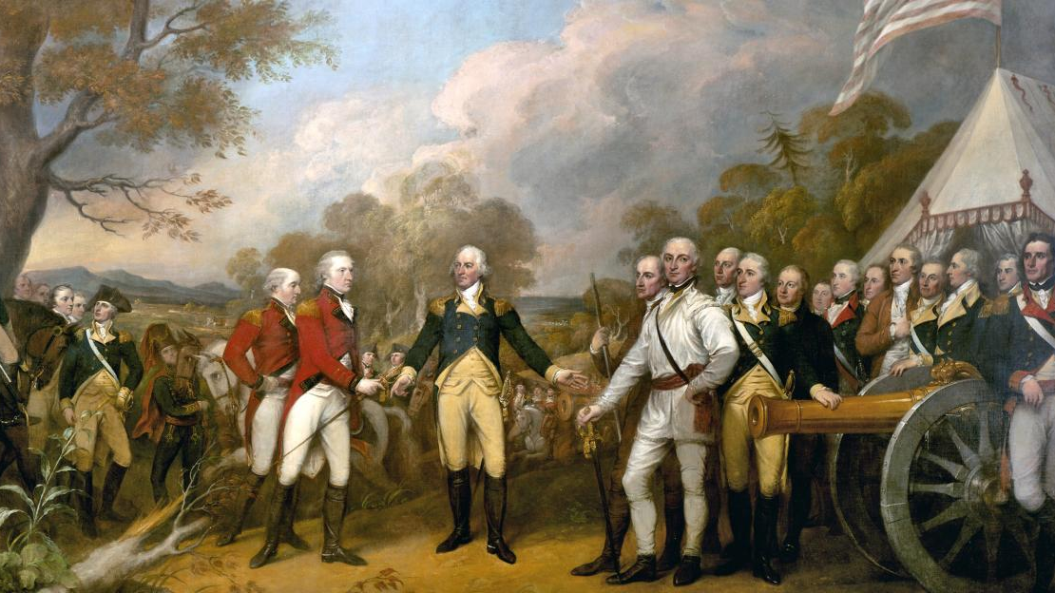
The Revolutionary War
Lecture 13

Slide 2
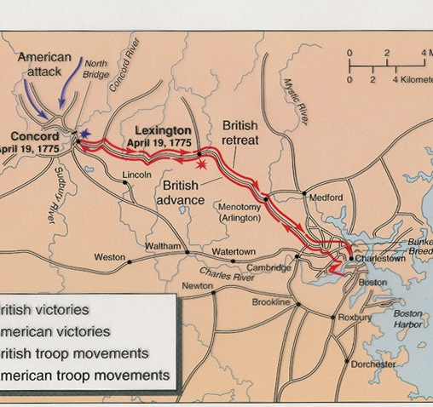
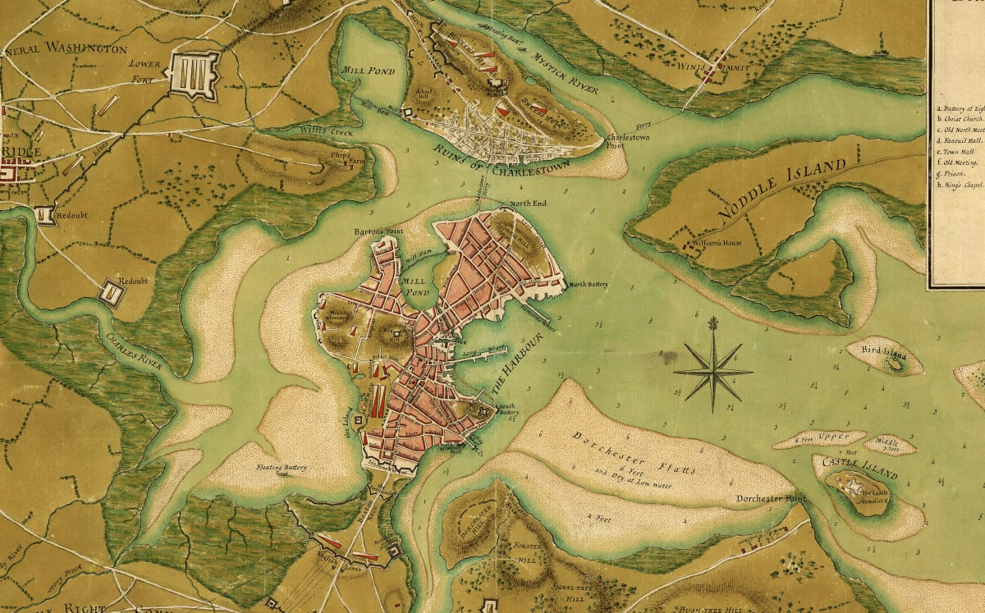
War Begins
April 19, 1775: British tried to seize colonial militia's weapons in Concord, MA; pushed back by colonial militia in Lexington
Colonists surround Boston
March 17, 1776: British retreat from Boston after colonists seize cannons from Fort Ticonderoga

Slide 3
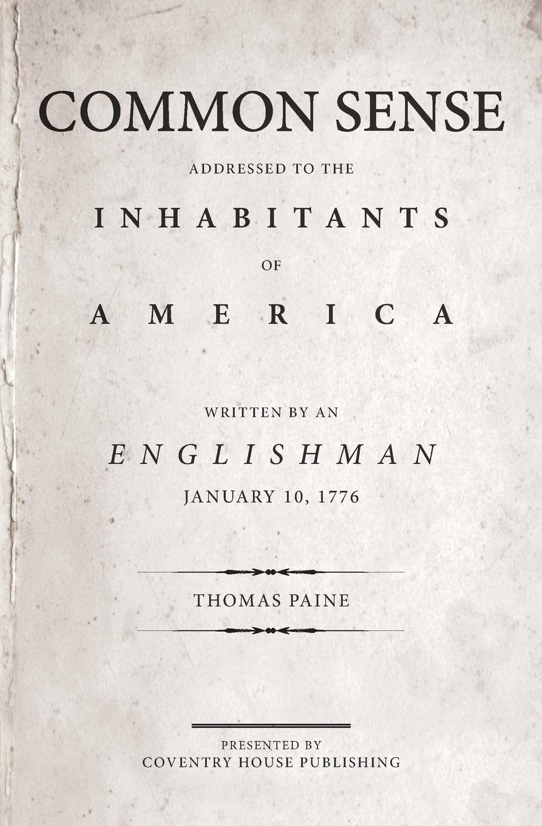
American Independence?
Initially: Colonists claim to fight in self-defense to protect their rights as Englishmen; attempt to make peace with the King
King rejected peace, would only accept total submission to Parliament
Thomas Paine: Wrote "Common Sense" in January 1776; argued that colonists needed independence from monarchy

Slide 4
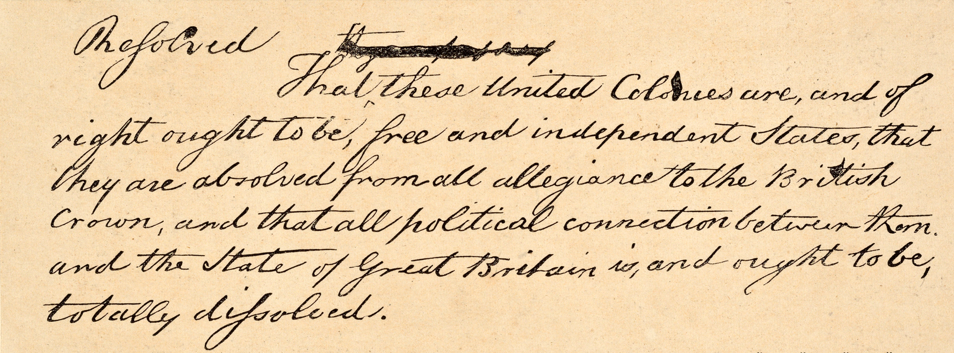
Road to Independence
Colonial governments started to promote independence
May 15, 1776: John Adams (MA) argued that British military force forced Americans to suppress loyalty to the King
June 7: Richard Henry Lee (VA) proposed a resolution of independence; "all political connection between [the colonies] and the State of Great Britain is, and ought to be, totally dissolved"

Slide 5
The Declaration of Independence
Thomas Jefferson (VA) tasked with writing Declaration of Independence, with help from John Adams, Benjamin Franklin, 2 others
Based on Lockean principles
People had fundamental rights
Government exists to protect those rights
When government fails to protect those rights, the people have a right and duty to change government

Slide 6
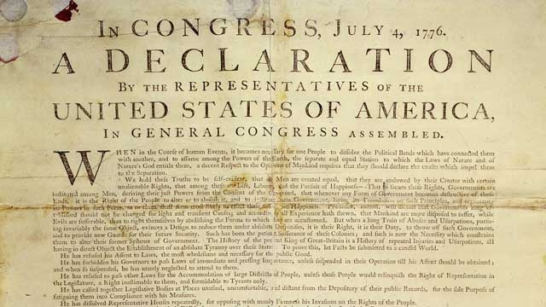
Rationale for Independence
King violated colonial charters, dissolved colonial governments, ignored their laws
Corrupted judicial system
Stationed standing army in colonies
Restricted trade
Taxation without representation

Slide 7
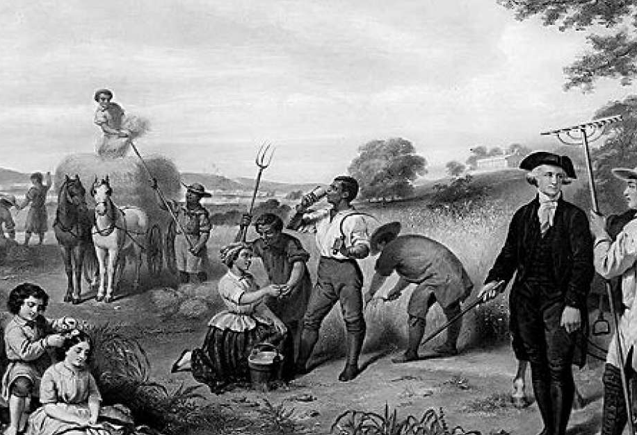
Race and Independence
Jefferson, a slaveowner, originally criticized the King for promoting slave trade
Clause removed in order to placate Southern colonies
Congress did not remove statement blaming slave revolts and Native American rebellions on the King
Did the Founding Fathers only seek freedom for White men?

Slide 8
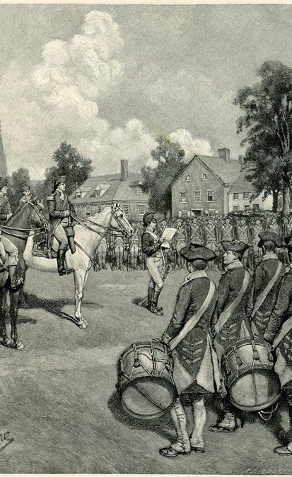
Independence Declared
July 2, 1776: Independence resolution approved
July 4: Text of the Declaration approved
Enforcing the document required winning the war; New York occupied by British

Slide 9
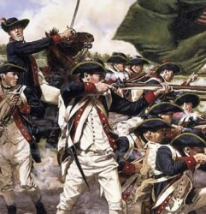
Fighting the Revolution
British: Strict discipline; officers taken from wealthy families, soldiers were poor; used traditional European fighting styles
Americans: Tried to fight like British at first, but came to adopt irregular tactics, inspired by Native Americans; limited terms of enlistment, chose own leaders—democratic style of military
Both sides could be brutal, exploited brutality for propaganda

Slide 10
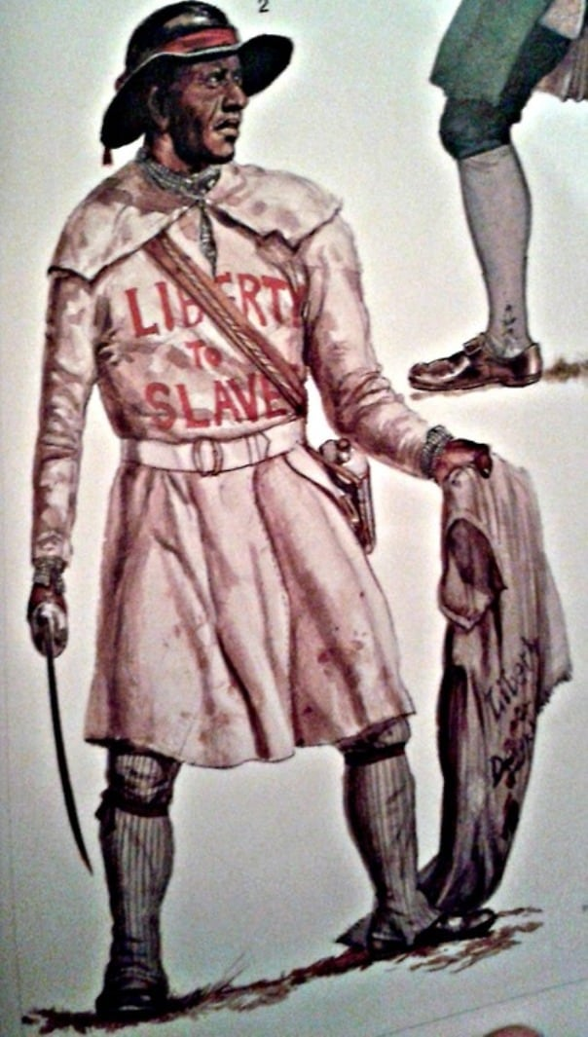
Race and the War
British governor of Virginia offered to free slaves who fought for British
Some free Blacks supported Americans
Native Americans thought British would protect their land better, sided against colonists

Slide 11
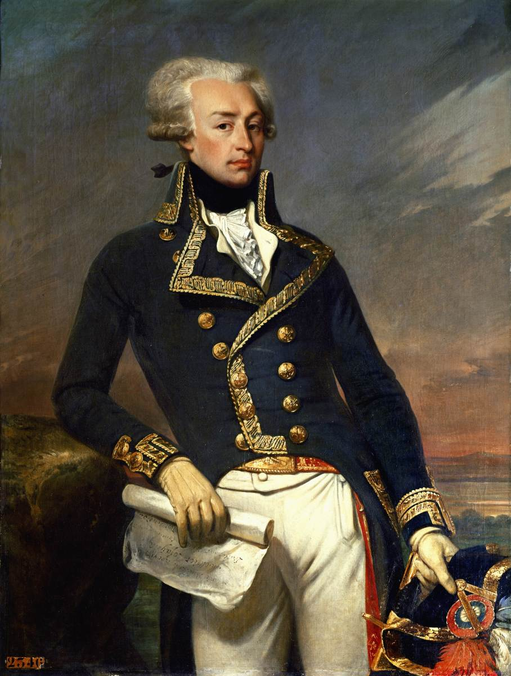
The War Goes Global
Americans knew they needed foreign aid to defeat Britain
French wanted revenge for 1763, but doubted Americans could win
1777: British lose Battle of Saratoga (NY), lose control of New England
French decided American cause worthwhile, dispatched navy in 1778

Slide 12
Disease and the War
https://www.youtube.com/watch?v=TWxDLG9_eOU

Slide 13
The War Ends
1781: Washington and French trap English at Yorktown
British surrender on October 19, 1781

