Slide 1
Road to Revolution
Lecture 12

Slide 2
Review: French and Indian War
Conflict between French and English over Ohio Country
English won
French ceded Canada, Great Lakes region to England
English spent lots of money on war, now were short on cash
Ben Franklin proposed unified colonial response

Slide 3
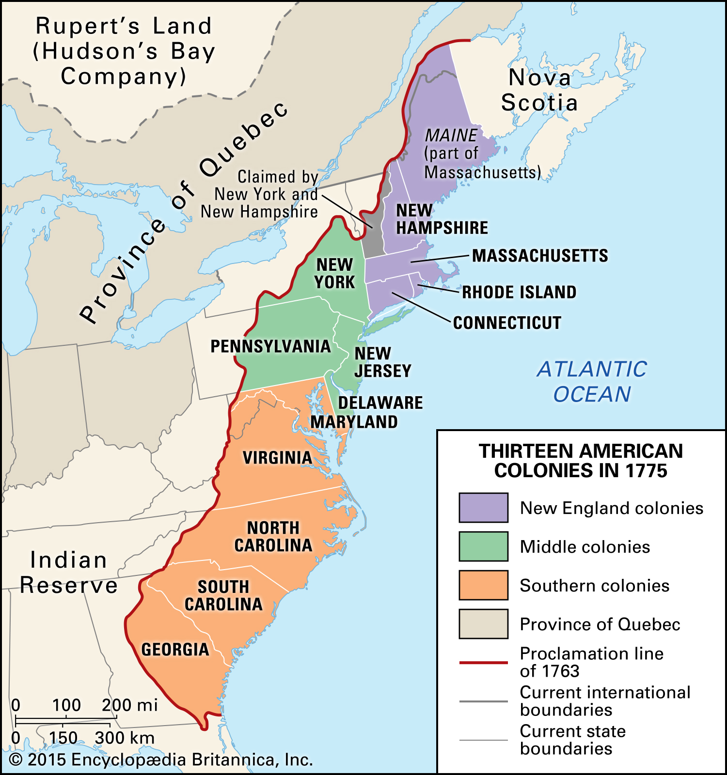
Restricting Americans
1763: Natives led by Pontiac attacked British in Ohio
British restricted colonial settlement past the Appalachian Mountains

Slide 4
England Needs Cash
English view: We fought to protect colonies from France, now colonies should pay for it
Colonial view: We didn't ask for this; we fought to support England

Slide 5
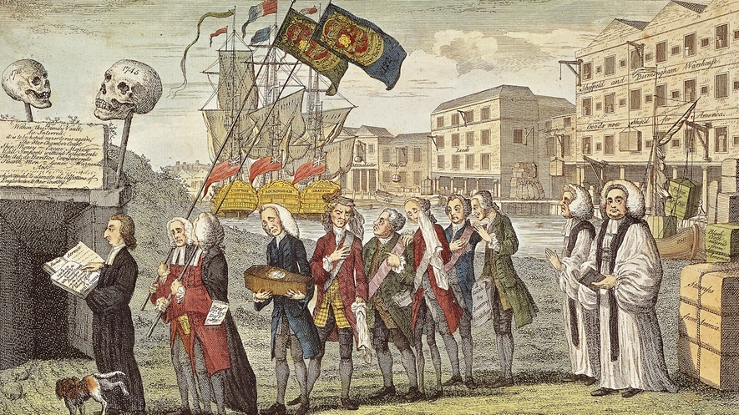
England Demands Taxes
1765: Stamp Act, required printed items be published on taxed paper
Expanded English courts in America

Slide 6
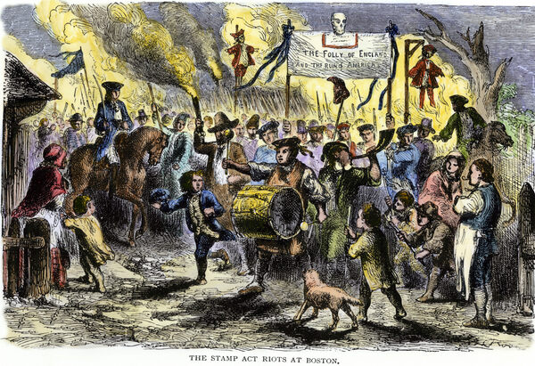
The Colonists Get Mad
Patrick Henry of VA led colonial response
House of Burgesses passed anti-Stamp resolution, other colonies followed
Protests in the street, violence against British enforcers
British repeal act, but declare they have the authority to pass taxes

Slide 7
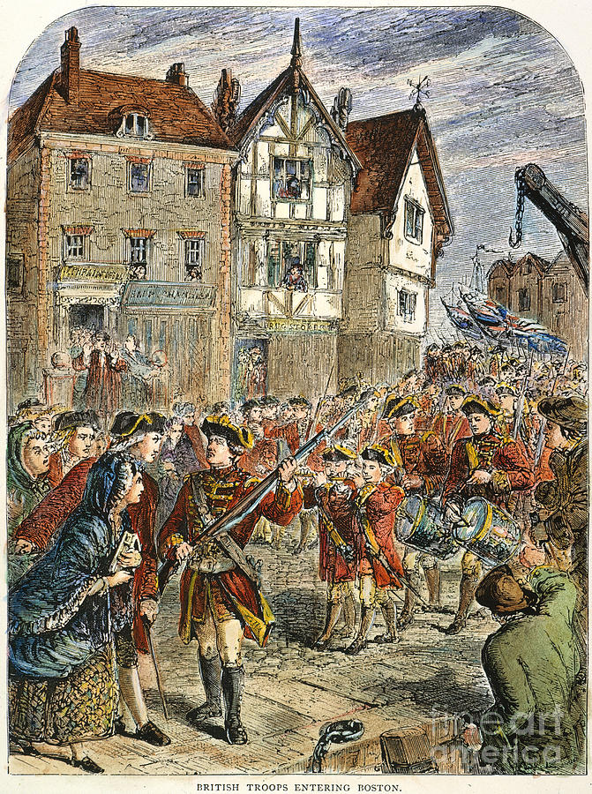
Occupation
1768: Massachusetts, led by Sam Adams and James Otis, claims colonies cannot be taxed by Parliament
British send troops into Boston, dissolve MA House of Reps
Standing army unusual, unwelcome
Colonists agree to stop buying British goods

Slide 8
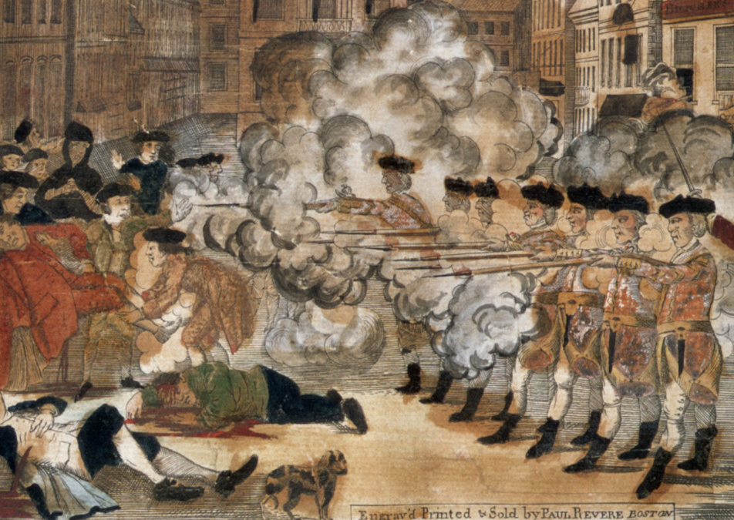
Violence
1770: Troops in Boston called in to put down brawl; fire into crowd, killing 5 ("Boston Massacre")

Slide 9
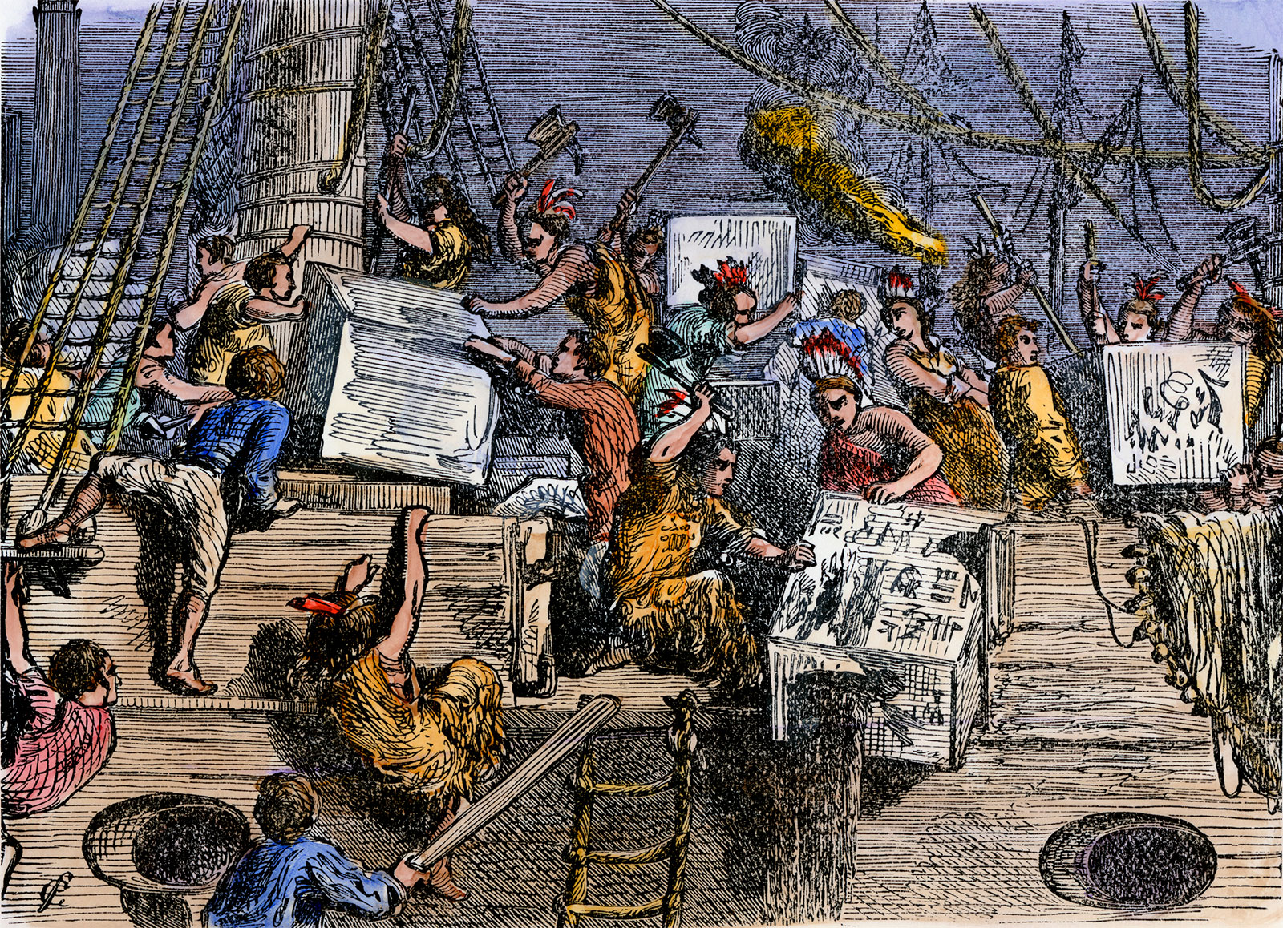
Tea
1773: Tea Act gave East India Company monopoly on tea trade
Bostonians responded by dumping tea in the sea

Slide 10
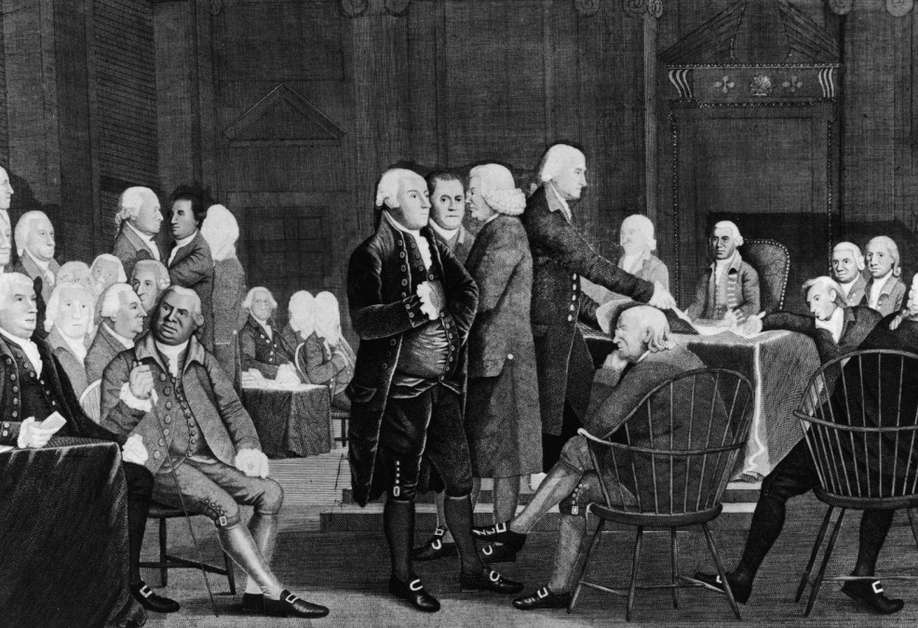
Breaking Point
1774: "Intolerable Acts"
Closed Boston Harbor
Restricted MA legislature
Gave colonial administrators special privileges
Forced colonists to house soldiers
Americans create Continental Congress to deal with it

Slide 11
Why did the colonists desire independence?
Economic
Political
Philosophical
Cultural
Religious
Racial

Slide 12
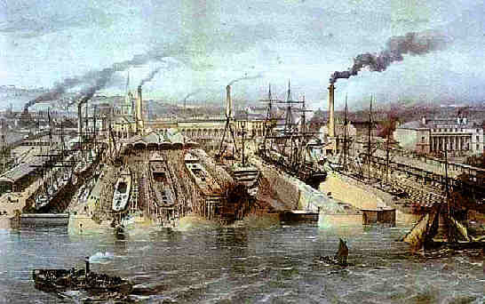
Economic
Colonists fight back against mercantilism
Colonists want free trade
Resent taxes
Most revolutionaries were wealthy traders

Slide 13
Political
"No taxation without representation"
Colonists wanted the same rights as Englishmen
English Civil War, Glorious Revolution meant Englishmen* should be free from tyranny, able to participate in government
That is, land-owning English*men*

Slide 14
Philosophical
"Whig" philosophy: History is the struggle between power and liberty
What is liberty?
Freedom=ability to own, control property
Unjust taxation=slavery
Liberty comes from nature, not the King
Colonists had to act decisively to protect their liberty in the face of British power

Slide 15
Cultural
Colonists believed British society was corrupted by bloated government, decadence, banks

Slide 16
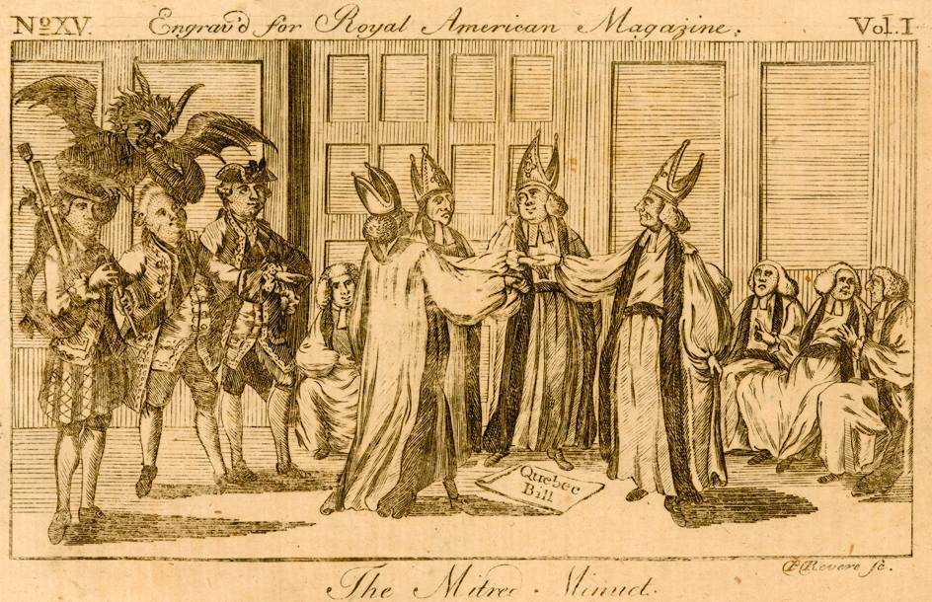
Religious
Fear that England would enforce Anglicanism, or even bring back Catholicism
Colonists viewed Catholicism=tyranny

Slide 17
Racial
Colonists wanted to encroach on Native land
Was the Revolution fought to protect slavery?
Not really, but race complicated the war effort

